Slide 1
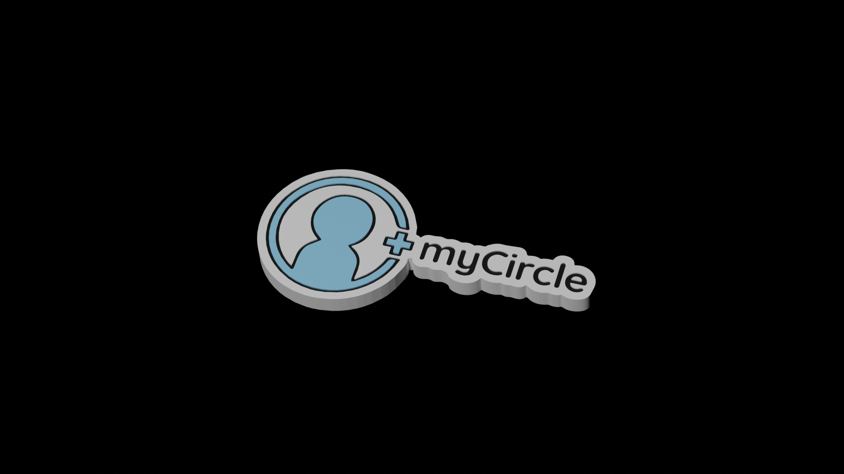
myCircle

Slide 2
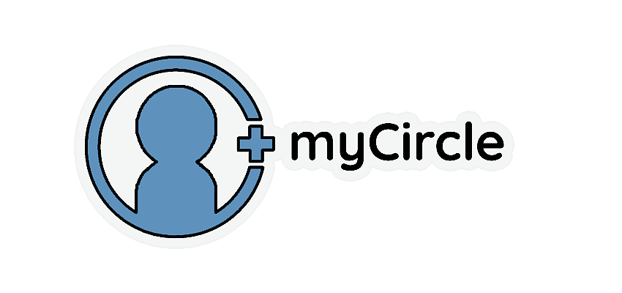
Who are we?
myCircle is a social media platform built around the idea of bringing friends, both real-life and online closer together through shared interests.
The platform would have a traditional style friends list that the user would populate themselves, and with each addition, that new friend would get organized into whatever lists of common interest or “Circles” that the user and the new friend might share.
If there are no matching shared interests, you would be able to find the users updates and posts in the “Full circle” list, where the user would see updates from all of their added friends.

Slide 3
The Problem vs The Solution
The Problem
The problem I see that exists in current iterations of social media platforms, is that you go through life and collect many friends, whether its one-time meetings on nights out or long existing friendships dating all the way back to school. I’ve found myself probably caring about 6-7 of those friends, yet I have to sift through 100’s of peoples posts about things I don’t really care about, to maybe get to 1 or 2 posts that I do.
The Solution
When creating an account on myCircle, you will be presented with a variety of different interests, maybe things like: coding, anime, electronics, gaming or films.
These would then become your “Circles”, or essentially separate “Timelines” if you were talking in Facebook terms. If you posted something in your coding circle, only those on your friends list that have selected coding as an interest would see it, in their own coding circle of friends. It’s a great way to filter out the noise and possibly a chance to have conversations with people that you had no idea was into that kind of thing.

Slide 4
The target audience
Anybody that enjoys being social on the internet or sharing anything about what they might be interested in

Slide 5
The market / The competition
Facebook would be the closest competitor as it does offer something very similar, and it would only be a few, but very key features that would set myCircle aside.
Being an interest-based social media platform would require an interest-first approach to socialising. Giving users the ability to create their own custom circles with a select group of friends would allow them to build something that feels like their social media platform, and have less requirements for group chats in favour of private circles. Though group chats would be implemented, having that functionality built right into the main part of the feed would be what sets us aside from the competition.

Slide 6
SWOT Analysis
Strengths
User Individuality - Customisable profiles allow users to feel more individual on the internet.
Interest First - Being built around people interests adds a new focus to how people socialise.
Flow control - Customisable feeds put the user in control of who and what they see, allowing users to create their own user-experience.
Weaknesses
Competition - Similar platforms exist such as Facebook and MySpace.
Data-breaches - Ensuring all user data is stored correctly and safely will be a key responsibility. Held data could be of value to individuals looking to steal it. Making sure all security measures are taken will be a priority.
Fake News - As a social media platform, we would have a responsibility to ensure that Fake News and misinformation are managed accordingly. While these, along with sided political agendas will not come from the company itself, we will have a duty of care in protecting our audience from users pushing such views.

Slide 7
SWOT Analysis
Opportunities
Customisation - Existing platforms don’t offer much in terms of customising the experience, though feeds can be edited, it takes some considerable effort to organize according finding people with similar interests or hobbies. This platform would be built around the idea of making that feel intuitive and seamless.
Better Targeted advertising - If we were to follow a similar advertising business model to Facebook, targeted advertising could be performed according to peoples selected interests and would advertise within that space. This would be a less invasive and more transparent approach
Threats
Competition - Existing platforms such as Facebook are massive, even so, Facebook’s user count has seen a decline as users migrate to TikTok. As myCircle will be built around peoples interests as opposed to being more of a meme sharing platform, it will take some consideration to employ features to draw in the younger demographic.
Data Breaches - Data breaches would be a concern as users lose trust in such platforms very quickly, with this in mind, it would be of the utmost importance to make sure all security measure are present to ensure the safety of all user data held.

Slide 8
PESTLE Analysis
Political
Great thought would have to be taken to find ways around reducing such things as Fake News and pushing political agendas, while this would not be coming from the company itself, measures would have to be taken to ensure that the users as individuals are not spreading misinformation
Economical
Both small and large businesses would have an excellent place to advertise as the majority of the site will be interest/hobby driven. Placed within user’s Circles, this approach would allow the targeted advertising system to be more transparent and would be almost expected to be seen where it would be.
Social
The intention of this platform is to bring people together in ways that existing platforms haven’t managed to yet, from an interest-based perspective. Users could create greater bonds with people that they already know in both the real life and online worlds by learning that they have shared interests that they might not have previously known about.

Slide 9
PESTLE Analysis
Technological
We would have a massive responsibility to ensure the safety of everyone’s data on the platform. Ensuring that the necessary security measures are implemented will be an absolute must to keep our users safe from data breaches.
Legal
As previously mentioned, we will have a great legal responsibilty to ensure all user data if very well looked after and that every security measure is in place. The data could be of potential value to those with such a mind to obtain the information illegally, which could result in legal action against the company.
Environmental
Being a Social Media Tech company, we would have to consider the environmental impacts of the energy we use. By 2040 it is projected that the tech industry will constitute 15% of global emissions, which is equivalent to half of that of the world’s transportation sector. Keeping this in mind, ensuring we operate on as much ‘green’ energy as a continued focus will be very important.

Slide 10
..any questions?

